Slide 1
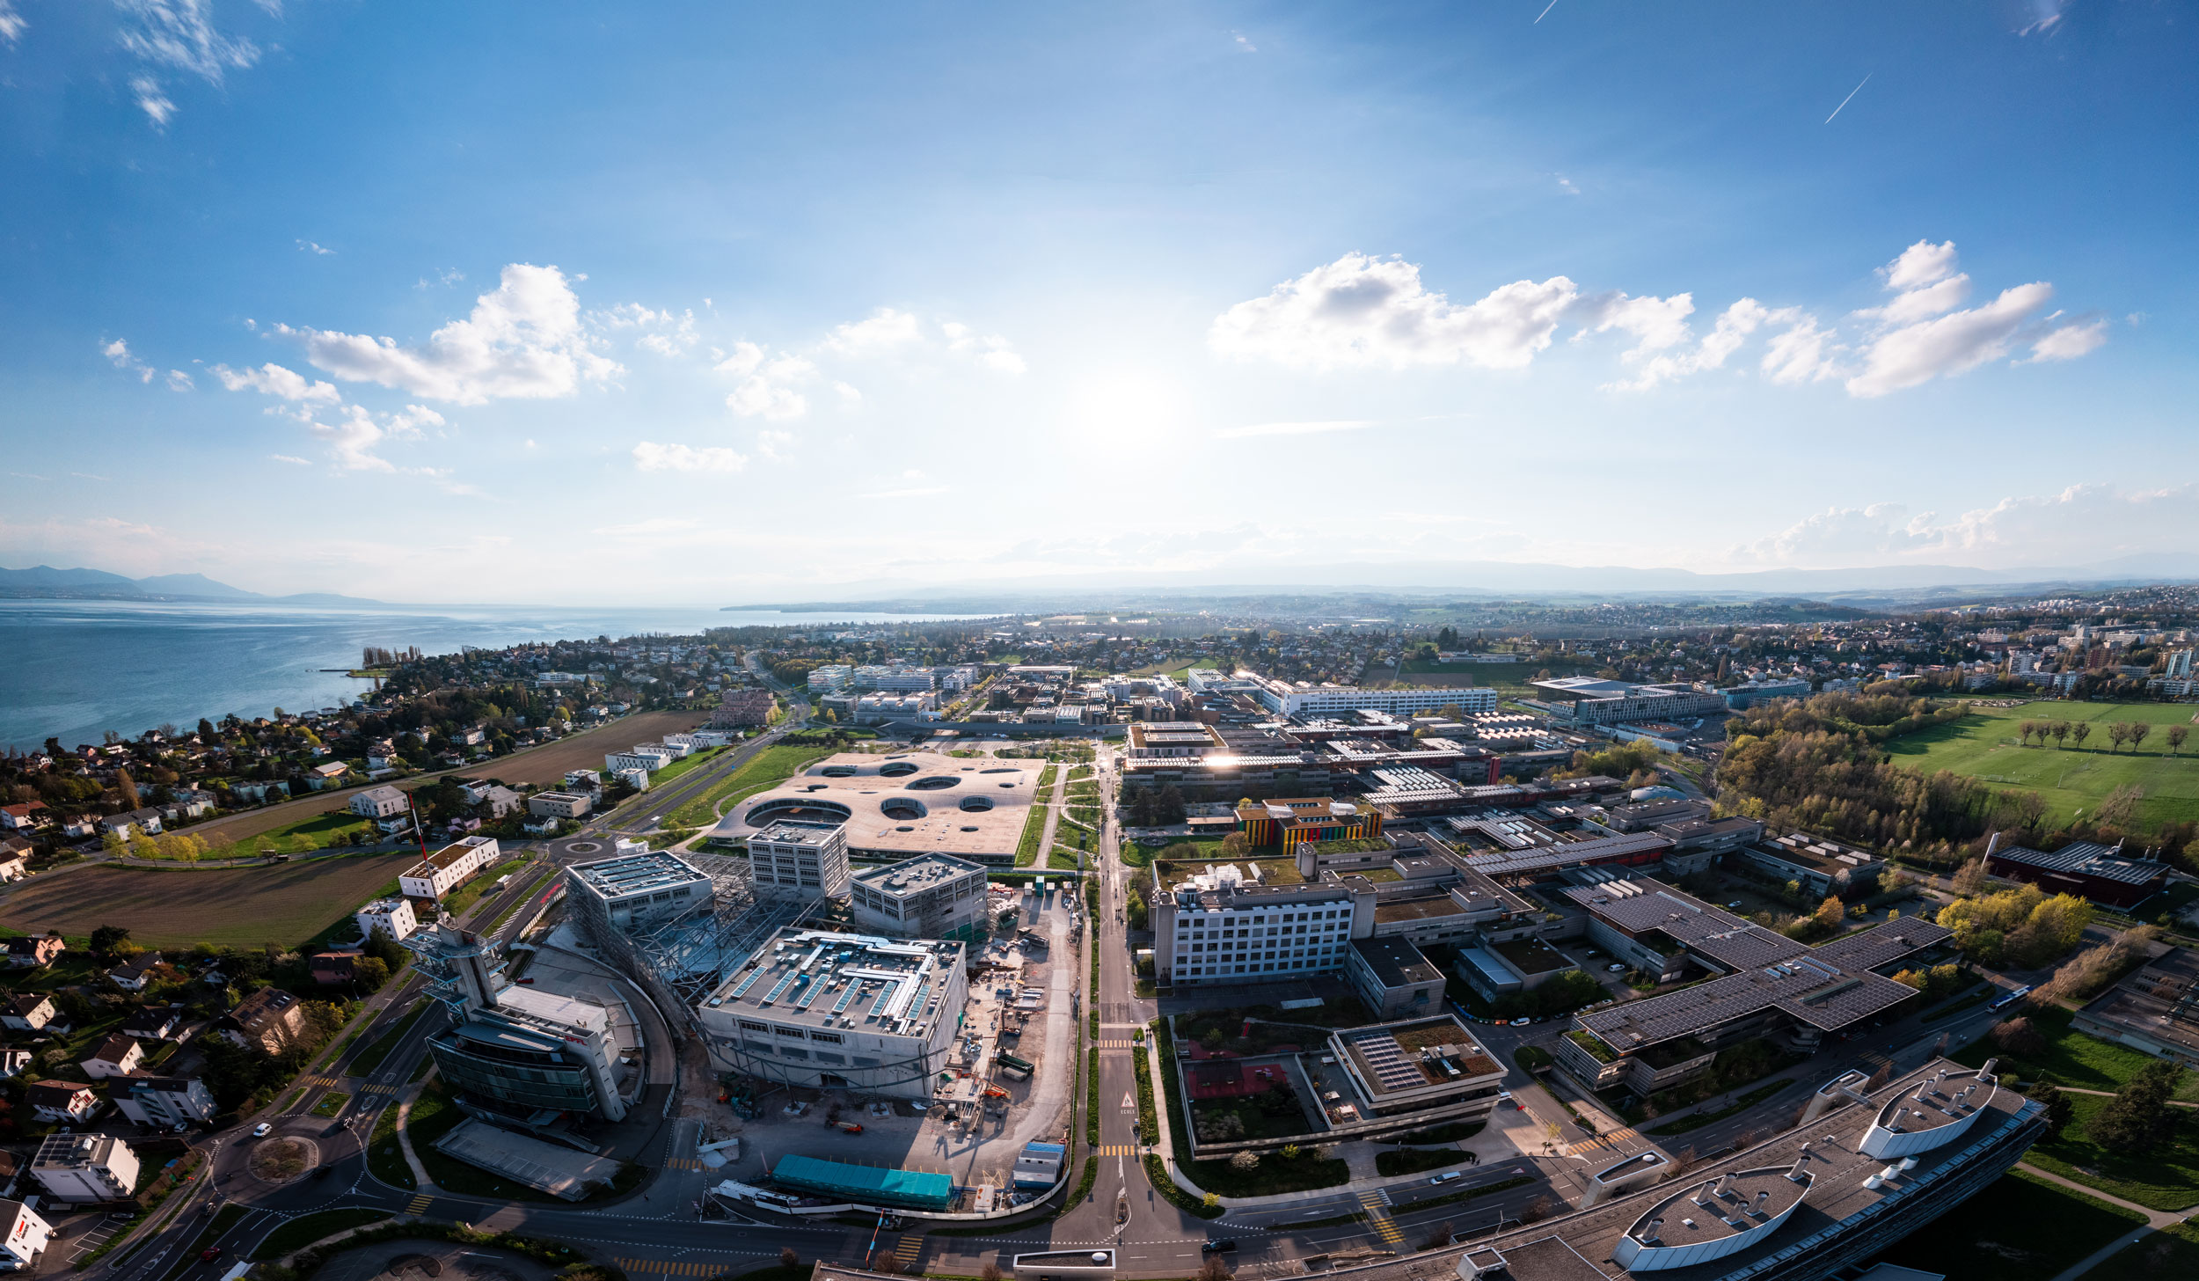
Semester Project
Student: William OH Supervisor :Jérôme Henri Kämpf Prof. Andrea Cavallero

Slide 2
AIM OF THE SEMESTER PROJECT
Modelize two areas in the canton of Valais. One in the Valley the other one in the mountains.
Visualise the actual energetic state of buildings and future state under climate change scenarios.
Bring guidelines for professionals and stakeholders in the Canton (renovation, solar panels).

Slide 3
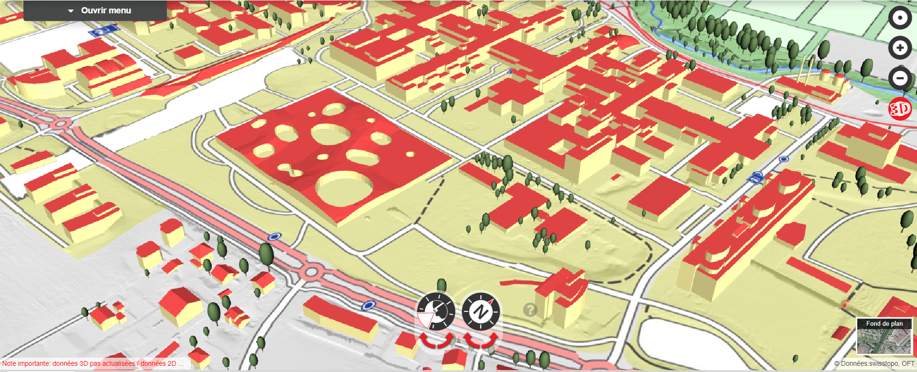
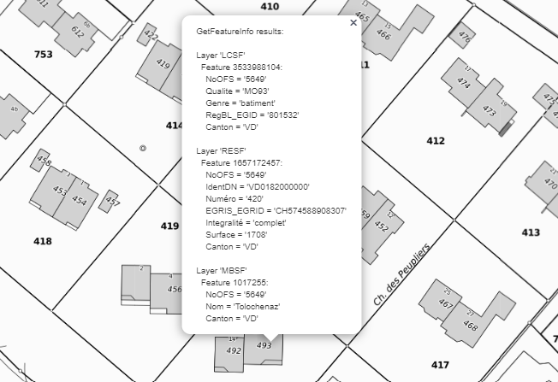
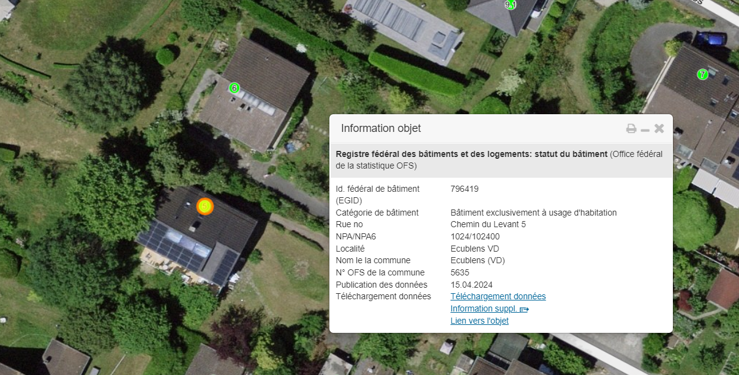
DATABASES FOR CITYSIM SIMULATION
Swiss building 3D
National MO
RegBL
Vector data of 3D buildings
Digital aerial photos
Photogrammetric methods for the
extraction
Official mensuration of buildings
EGID number
extraction
Information about:
Creation date, renovation, solar panels, heating system
extraction

Slide 4
ELEMENTS TO RUN CITYSIM
Normal case 3D
Swiss building 3D
Floor, roof, wall measurements
Precise 3D rendering of buidlings
Geometrical
intersection
Land measurements
National MO
EGID
Relevant infos for each building
Use EGID to get RegBL infos
Other infos: Heating system, creation date
RegBL

Slide 5
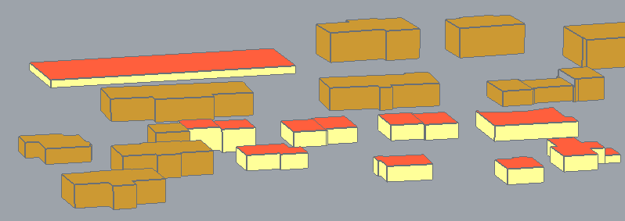
ELEMENTS TO RUN CITYSIM
Normal case 2.5D
2.5D rendering
Extrude based on number of floors
Land measurements
National MO
EGID
Relevant infos for each building
Use EGID to get RegBL infos
Other infos: Heating system, creation date
RegBL

Slide 6

ELEMENTS TO RUN CITYSIM
Valais case
Swiss building 3D
Floor, roof, wall measures
Precise 3D rendering of buidlings
Geometrical
intersection
Land measures
National MO
EGID
Relevant infos for each building
Use EGID to get RegBL infos
Other infos: Heating system, creation date
RegBL

Slide 7
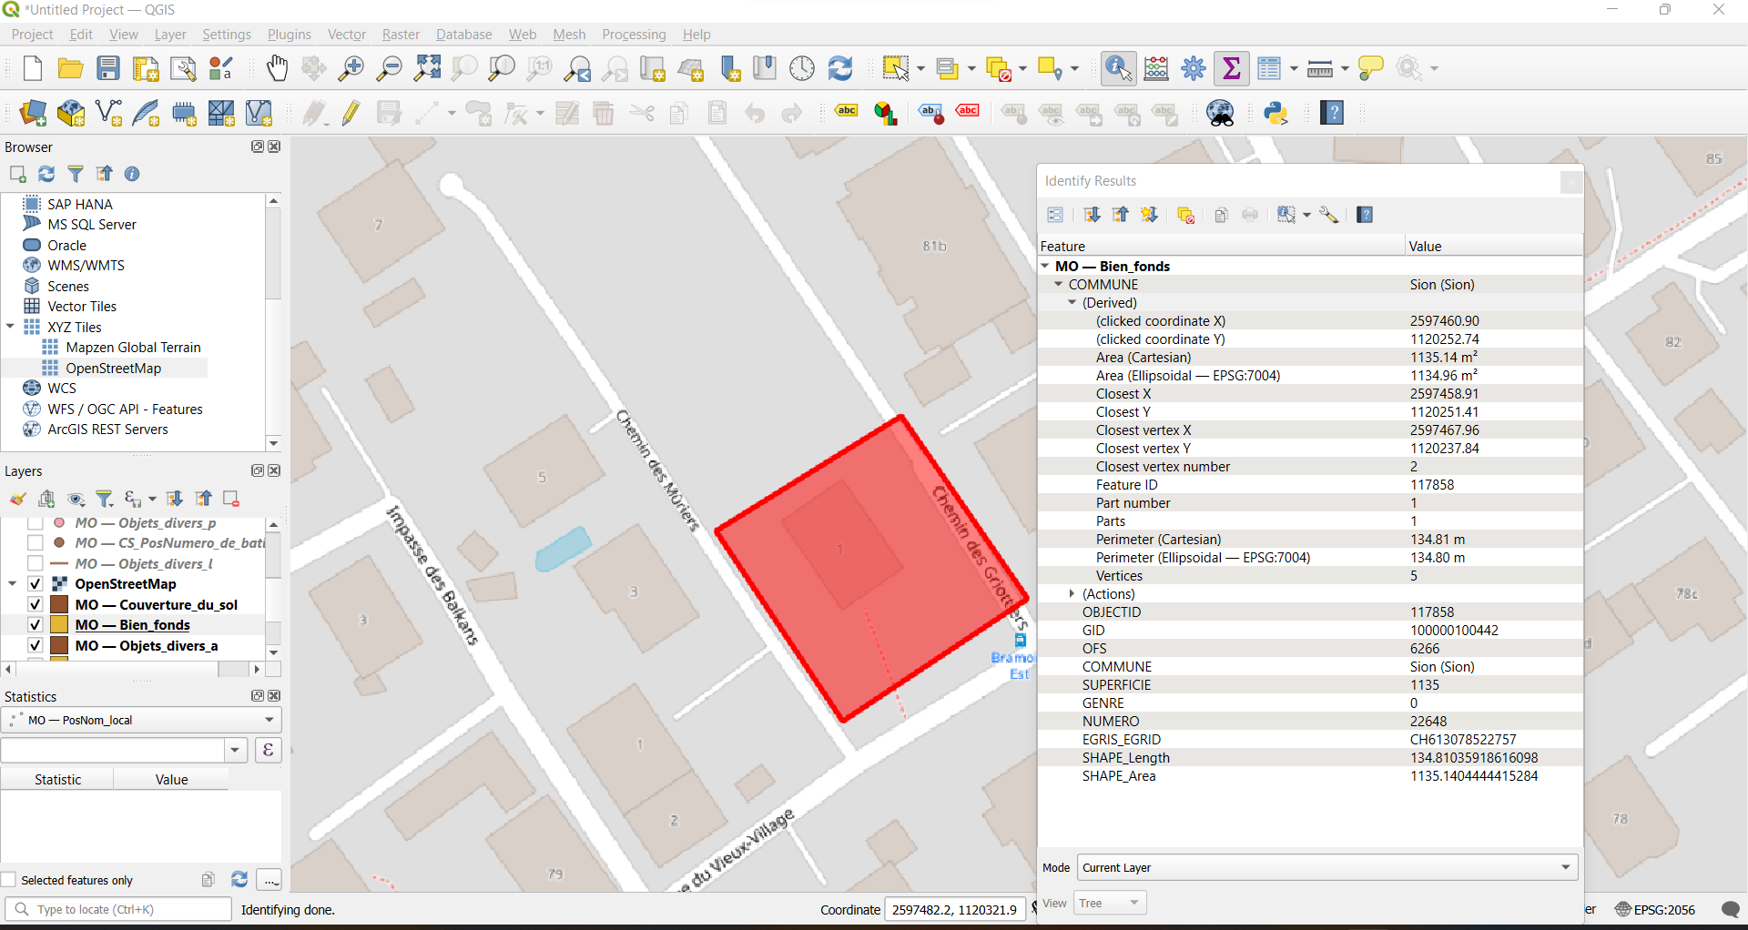
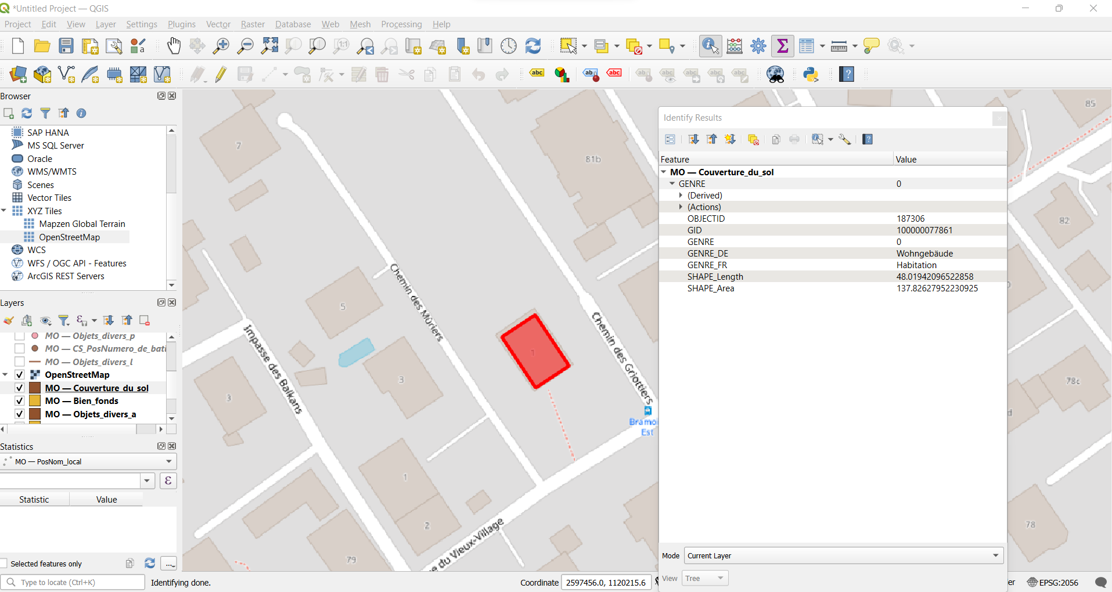
NEW DATABASE FOR VALAIS
However, no information on EGID only EGRID
EGRID is The Federal Parcel Identifier (a number associated to each Parcel)

Slide 8
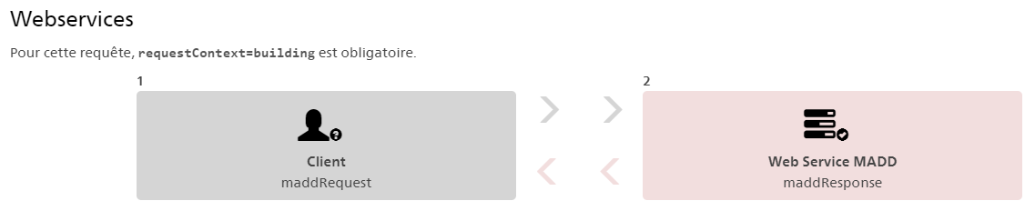
ELEMENTS TO RUN CITYSIM
Get EGID from EGRID
Using the RegBL API and the EGRID we can get the EGID numbers of the buildings on the parcel.
Geometry to associate each EGID to the corresponding building

Slide 9
ELEMENTS TO RUN CITYSIM
New Valais case 3D
Swiss building 3D
Floor, roof, wall measures
Precise 3D rendering of buidlings
Geometrical
intersection
Land measures
National MO
EGRID
Get EGID using API
Relevant infos for each building
Other infos: Heating system, creation date
RegBL
Get RegBL infos

Slide 10
FLOWCHART OF PROCESS
Database
Extract Geopackage
Select zone of interest
RegBL API
EGIDs from EGRID
RegBL API
Building info from EGID
Use geometry to associate EGID to buildings
Simulation with CitySim
xml file for city sim
Output file
Re-write in geopackage
View results QGIS

Slide 11
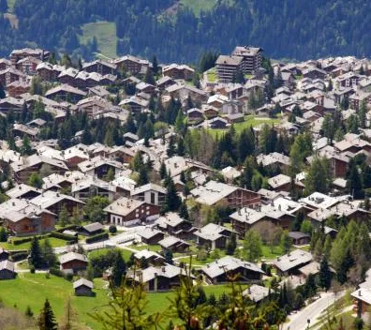
PICKING THE CASE STUDIES
Verbier
Famous skis resort in Valais
High altitude climate
Heavy snowfalls in winter & cool summer
Altitude : 1500m

Slide 12
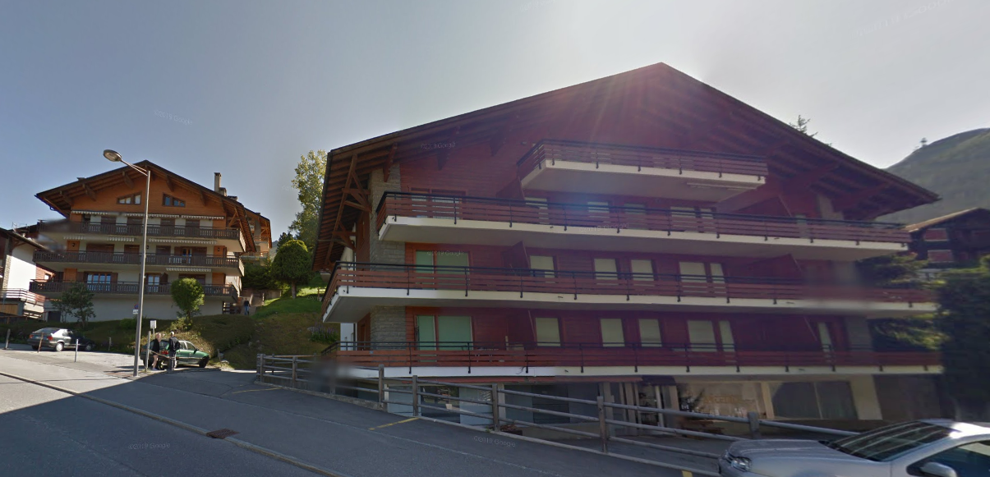
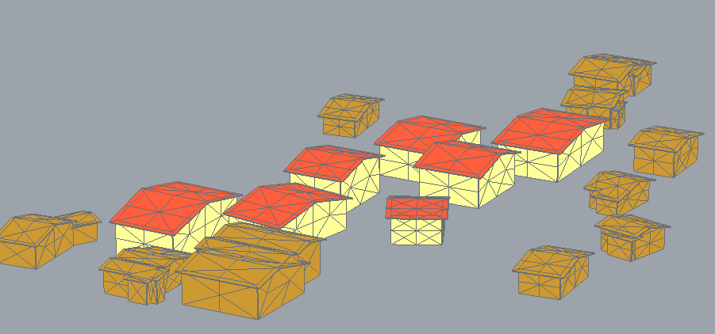
PICKING THE CASE STUDIES
Modeling Verbier
Actual buildings (maps street view)
Building modelized

Slide 13
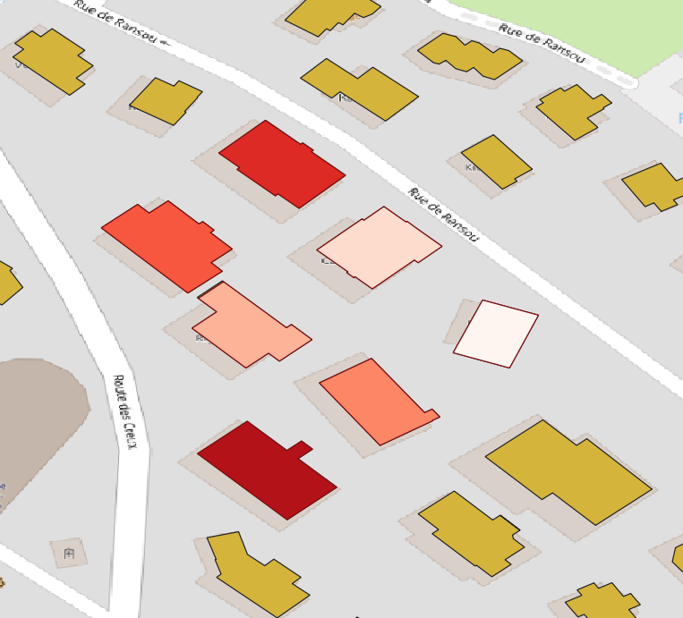
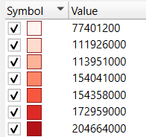
PICKING THE CASE STUDIES
Modeling Verbier
heating yearly demand for modelized building in Wh

Slide 14
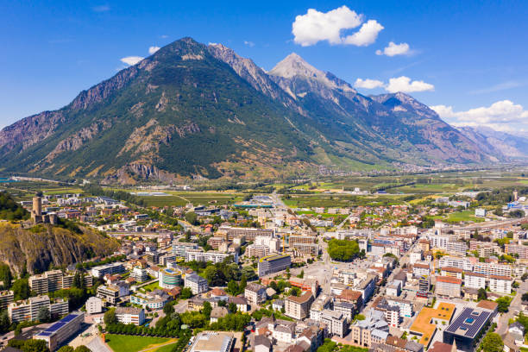
PICKING THE CASE STUDIES
Martigny
2nd biggest city in Valais ~20,000 inhabitants
Light snowfall in winter & cool summer
Crossroads between Italy, France and Switzerland
Altitude : 470m

Slide 15
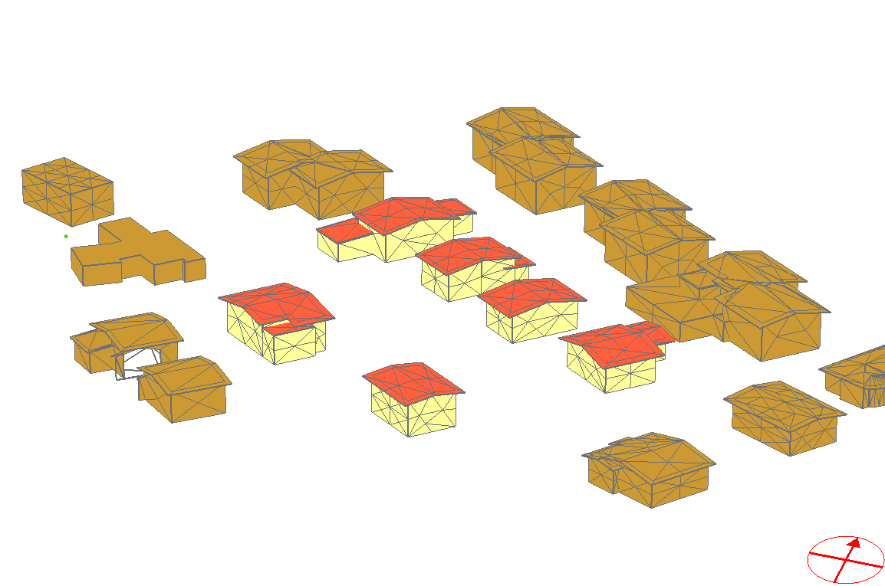
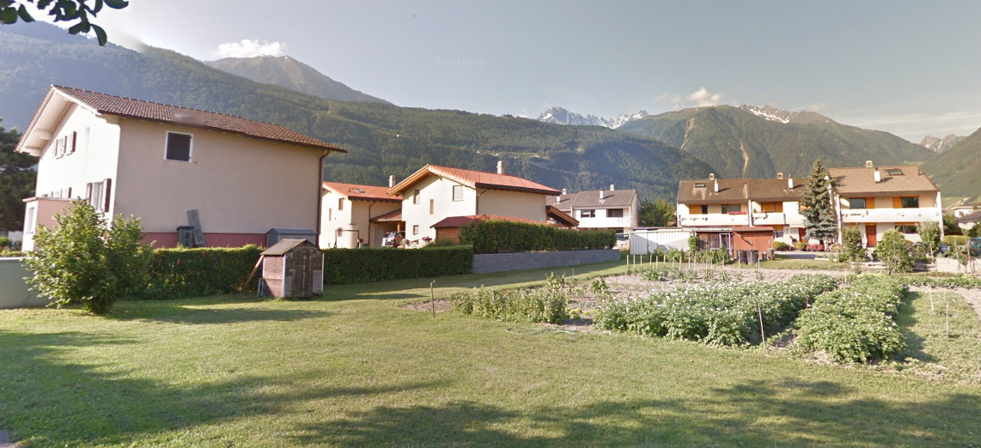
PICKING THE CASE STUDIES
Building modelised
actual buildings (maps street view)

Slide 16
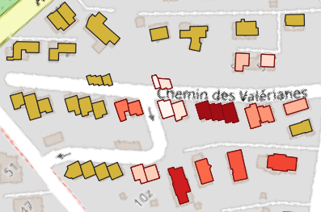
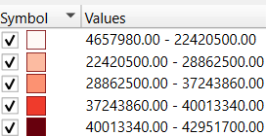
PICKING THE CASE STUDIES
Martigny
Heating yearly demand for modelized building in Wh

Slide 17
Renovations scenarios : heating system
Three main heating systems
Heat pump
Oil fired heating system
Natural gaz heating
Which one is more economical and environmental friendly?

Slide 18
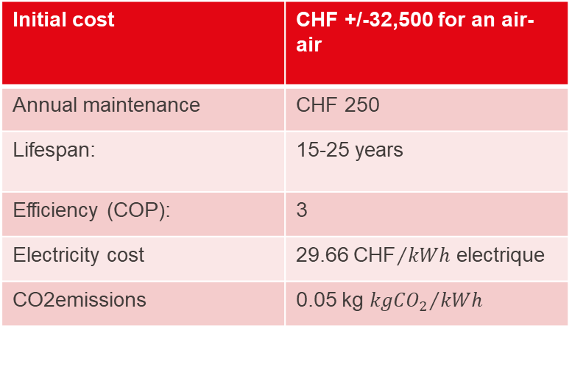
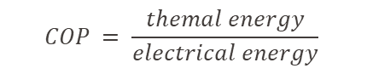
Renovations scenarios : heating system
Heat Pump
Initial cost | CHF +/-32,500 for an air-air
Annual maintenance | CHF 250
Lifespan: | 15-25 years
Efficiency (COP): | 3
Electricity cost | 29.66 ${\text{CHF}}/{kWh}$ electrique
CO2emissions | 0.05 kg ${{kgCO}_{2}}/{kWh}$
$$COP = \frac{themal energy}{electrical energy}$$
$$Cost per kWh of thermal energy = \frac{29.66}{3}≈ 9.87 cts/kWh$$

Slide 19
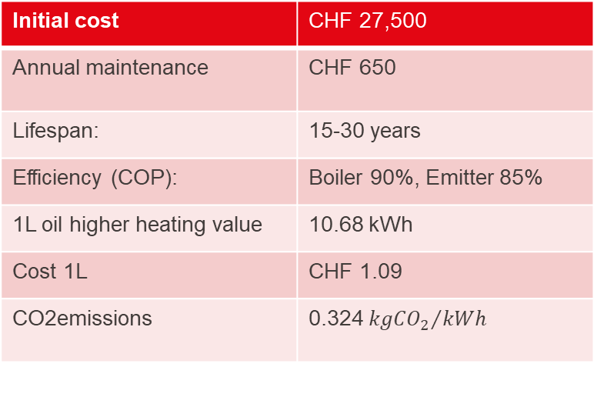

Renovations scenarios : heating system
Oil-Fired Heating System
Initial cost | CHF 27,500
Annual maintenance | CHF 650
Lifespan: | 15-30 years
Efficiency (COP): | Boiler 90%, Emitter 85%
1L oil higher heating value | 10.68 kWh
Cost 1L | CHF 1.09
CO2emissions | 0.324 ${{kgCO}_{2}}/{kWh}$
Cost per kwh of heat$= \frac{1.09 CHF}{10.68 kWh}=10.2cts/kWh$
Effective cost$= \frac{29.66}{3}≡\frac{10cts/kWh}{0.90 ×0.85}$ = 13.3 cts/kWh

Slide 20
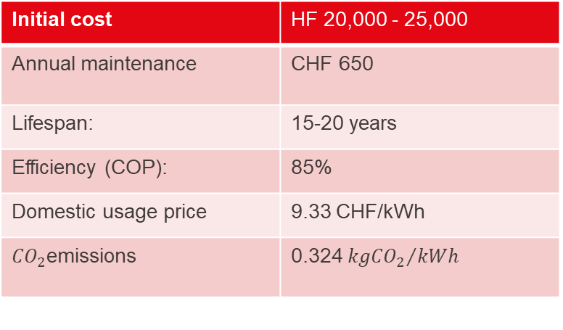
Renovations scenarios : heating system
Natural Gas Heating
Initial cost | HF 20,000 - 25,000
Annual maintenance | CHF 650
Lifespan: | 15-20 years
Efficiency (COP): | 85%
Domestic usage price | 9.33 CHF/kWh
${CO}_{2}$emissions | 0.324 ${{kgCO}_{2}}/{kWh}$
Cost per kwh of heat$= \frac{1.09 CHF}{10.68 kWh}=10.2cts/kWh$
Effective cost$= \frac{9.33}{0.85}≡10.97$cts/kWh

Slide 21
Renovations scenarios : heating system
Heat pump energy requirement to beat other heating
Heat pump already better than oil fire heating system
$$Total cost\left(without energy\right)={Initial cost}_{NG}+{Total maintenance}_{NG}$$
$Total cost\left(without energy\right)={Initial cost}_{HP}+$ ${Total maintenance}_{HP}$
$$Energy \left(Kwh\right)=\frac{{ Total Cost(without energy)}_{NG}−{Total Cost (without energy)}_{HP}}{{ Total Cost(without energy)}_{HP}−{ Total Cost(without energy)}_{HP}}$$
$$Energy \left(Kwh\right)=\frac{2, 000}{0.011} =181, 818 kWh, \sim 3 years\left(Martigny\right), \sim 1 year (Verbier)$$

Slide 22
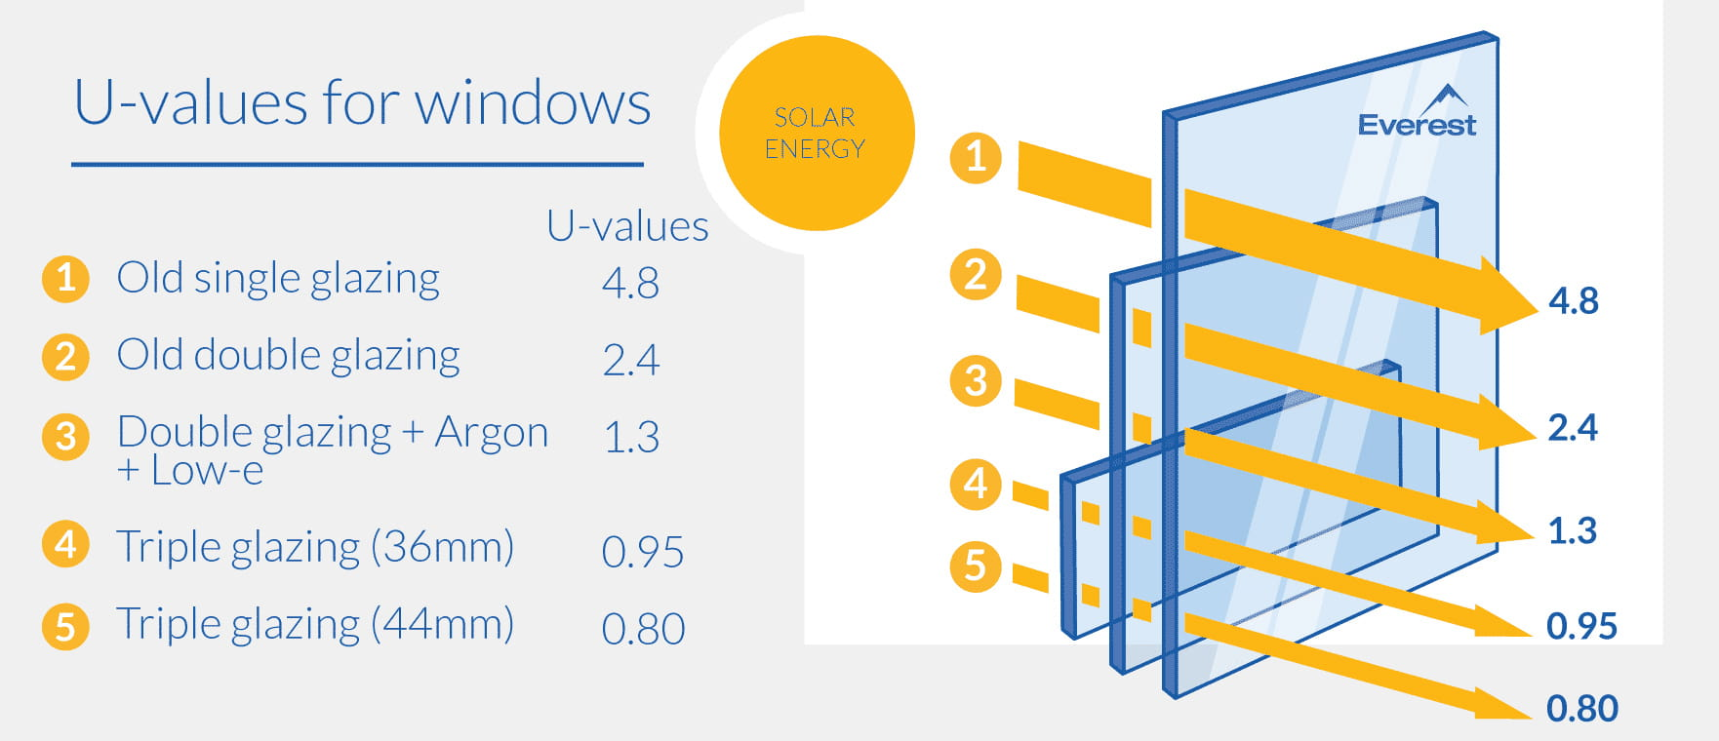
Renovations scenarios : window insulation
Impact of changing windows to new double glazing
Current window glazing given to CitySim 2.3 (old double panel)
IAdded a list to indicate which building for window renovation

Slide 23
Renovations scenarios : exterior wall insulation
For exterior insulations Expanded Polysterene (EPS) was chosen
Thermal performance: (Conductivity = 0.036 W/(m·K))
Lightweight : 11 to 32 kg/m3
Cost-effective : ~ 300 CHF m3
Most used in switzerland

Slide 24
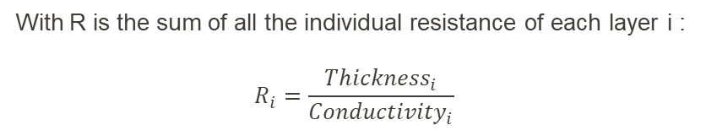
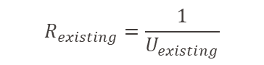


Renovations scenarios : exterior wall insulation
Calculation of EPS Thickness for Wall Insulation
The U-value is the inverse of the thermal resistance $u=\frac{1}{R}$
With R is the sum of all the individual resistance of each layer i :
$$R_{i}=\frac{{Thickness}_{i}}{{Conductivity}_{i}}$$
With:
$$R_{total}=\frac{1}{0.25}$$
$$R_{existing}=\frac{1}{U_{existing}}$$
$R_{total}=$ $R_{existing}+ R_{EPS}$

Slide 25
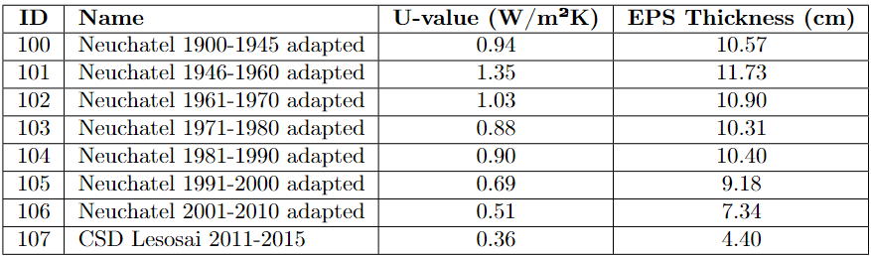


Adding external wall insulation
$R_{total}=$ $R_{existing}+ R_{EPS}$
${Thickness}_{EPS}=$ $R_{EPS×{Conductivité}_{EPS}}$
Conductivity EPS $≈$ 0.036 W/(m·K)
I then added a renovated version for each wall in the base file

Slide 26
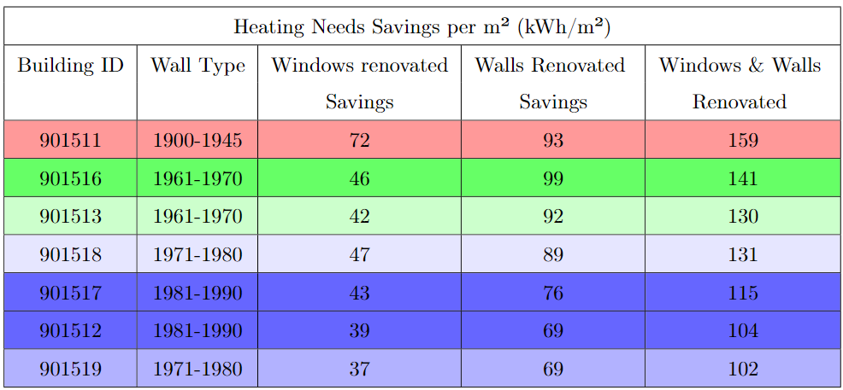
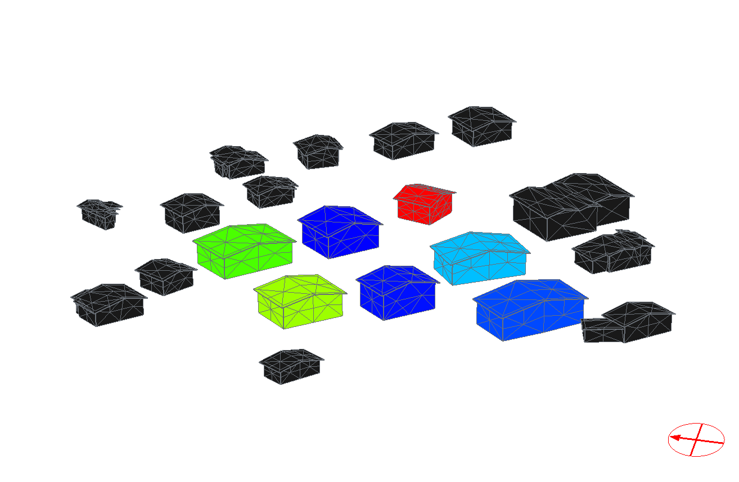
Result from wall & windows renovations Verbier
Renovating the walls results in nearly twice the energy savings compared to renovating the windows alone
Considering 100m of total envelope surface :
15, 000 CHF Wall
10, 625 CHF

Slide 27
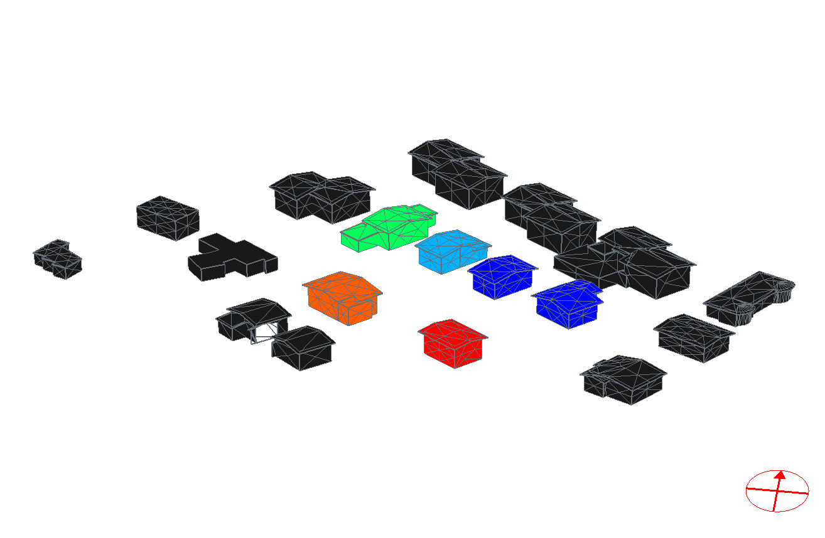
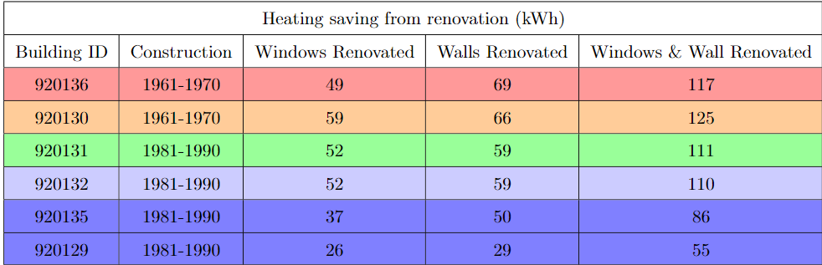
Result wall & windows renovations Martigny
Renovating the walls are similar to the windows alone
Considering 100m of total envelope surface :
15, 000 CHF Wall
10, 625 CHF Window

Slide 28
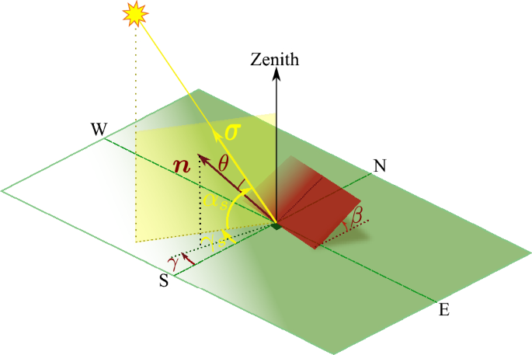
Renovation scenario: PV integration
Calculating the azimuthal angle of the roof elements
I calculated the orientation of each roof geometrical element
Project the normal of the geometrical element
Calculate the azimuthal angle
North : don’t add panels
South : add solar panels
Note: range easily modulable to restrict range

Slide 29
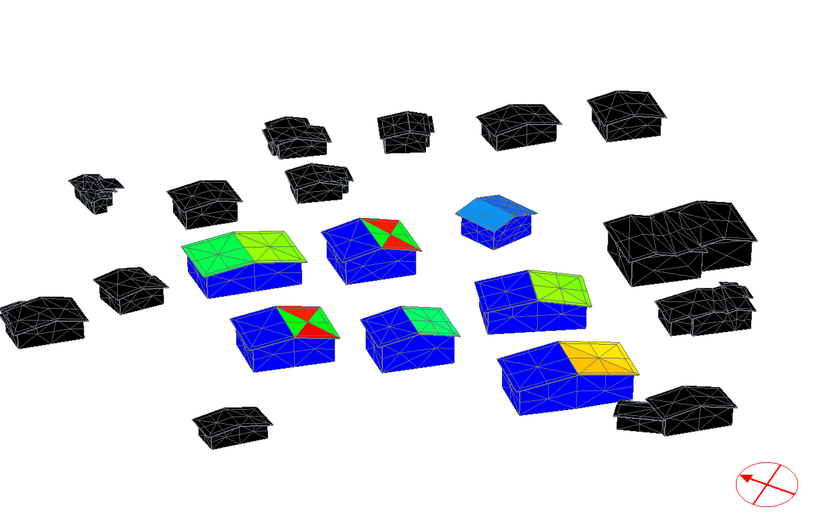
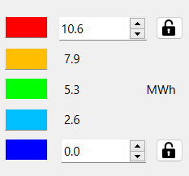
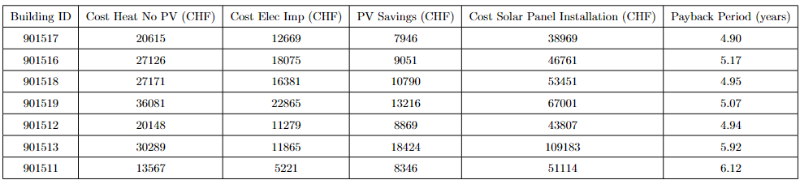
Result : PV integration Verbier
~ 5 years to repay solar panels

Slide 30
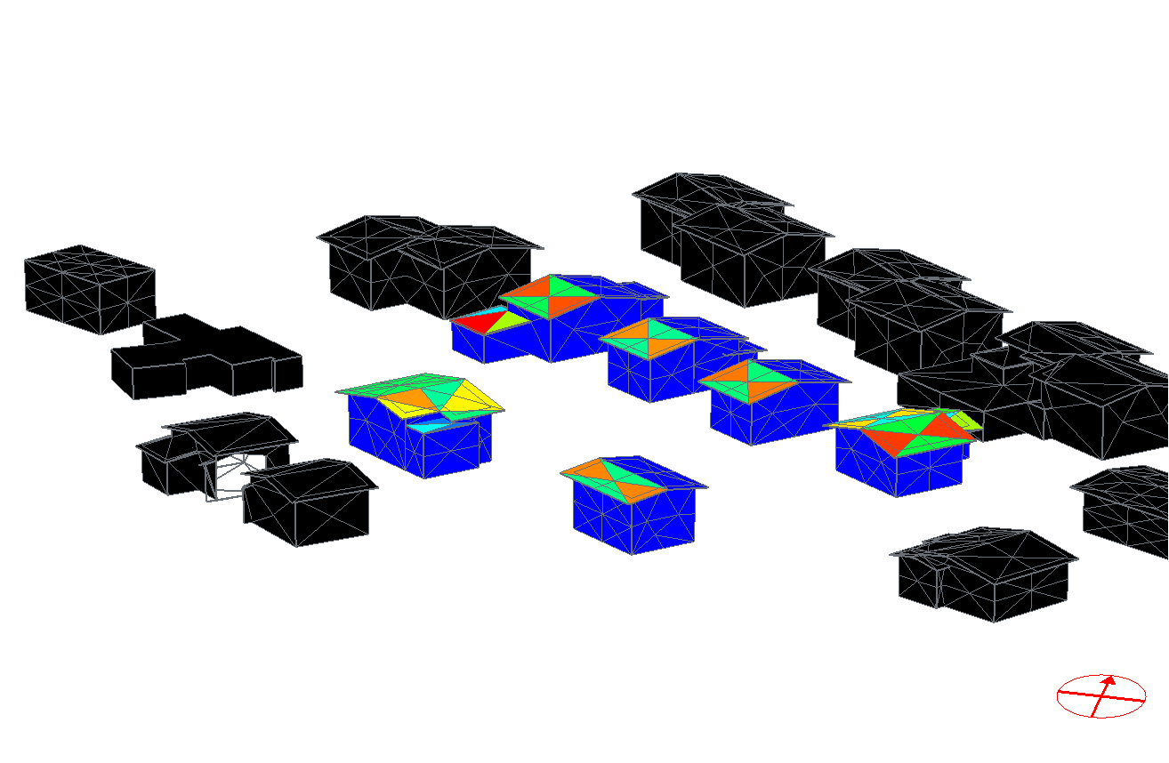
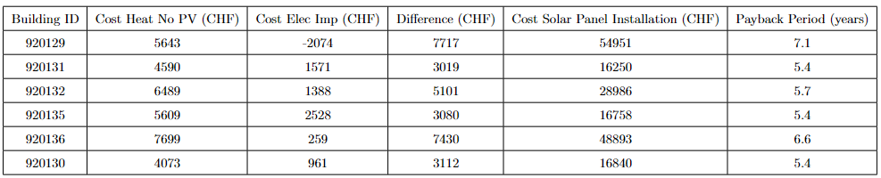
Result : PV integration Martigny
Payback time slightly longer than Verbier
Lower heating needs
Better to use solar energy for heating
29.66 cts elec imported
16.9cts reinjected
Geometry

Slide 31
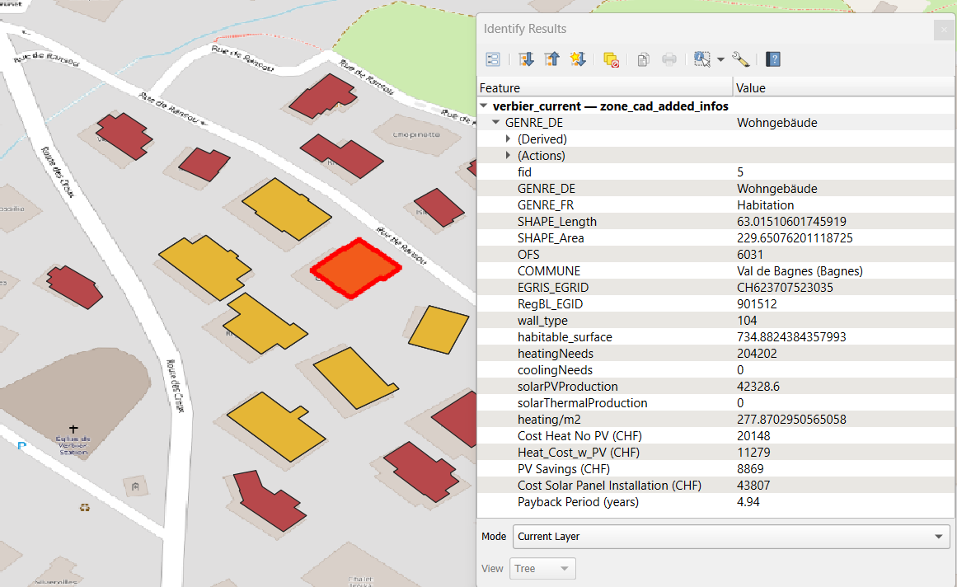
Information visible in QGIS
Quick visualisation of building potential attributes
Colored maps giving key insights
Modulable
Interactive

Slide 32
Renovation scenario: climate change
Three scenarios examined:
RCP2.6 (2050) : Most optimistic scenario. Radiative forcing of 2.6 in 2100.
RCP4.5 (2050) : Stabilisation where global emission peak around 2040 then decline. Radiative forcing of 4.5 in 2100.
RCP8.5 (2050): Most pessimistic. No change in current emission trends. Radiative forcing of 8.5 in 2100.

Slide 33
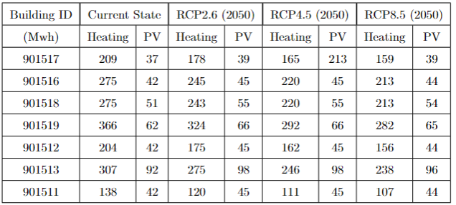
Renovation scenario: climate change Verbier
Very slight increase in solar panel production
Best scenario: at most 15% reduction in heating needs
Worst case scenario : at most 35% reduction in heating need

Slide 34
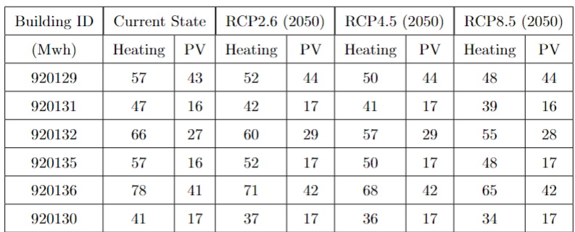
Renovation scenario: climate change Martigny
Even smaller increase in solar panel production
Best scenario: at most 10% reduction in heating needs
Worst case scenario : at most 15% reduction in heating need

Slide 35
Recommendations for Stakeholders in Valais
Encourage heat pumps
Implement Solar Panels
Sufficient available data to have good models
Consider Climate Change Scenarios

Slide 36
Accomplishements of the project
Possible to have reliable and precise building information in Valais through open databases.
Possible to test different renovation and climate change scenarios in the Valais region
Visualize directly and intuitively the result in QGIS

Slide 37
Next steps
Evaluate more renovation scenario which didn’t have time to be implemented : roof renovation, floor, triple panels windows…
Evaluating the cost of renovation for different possible materials
Calculate precisely the price of window and wall renovation for each building

Slide 38
QUESTIONS

Slide 39
NEXT STEPS
prepare renovation, climate change, renewables integration scenarios for the case-studies
Add the information collected in the simulation into the Geopackage for a visual understanding
Go more into depth with parametric study / optimisation algorithm

Slide 40
Sources
https://teamce.com.au/wp-content/themes/cecsgroup/_datasheets/concrete-formwork/styrene-insulation/Polystyrene.pdf
https://www.billes-de-polystyrene.com/epsfr/bloc-polystyrene-expanse-20kg-100-120-95.html#:~:text=Bloc%20de%20polystyr%C3%A8ne%20expans%C3%A9%2020kg,cm%20%C3%A0%20339%2C00%20%E2%82%AC
Altis. Comprendre les tarifs: Electricité, 2024.
Sinergy. Fiche tarifs 2024, 2024. Houzy. Online, 2024.
Müba Energietechnik. Environnement, appareil, système de chauffage, technique de condensation, mazout, chaleur, énergie, gaz, émissions, vaporisation, eau, 2024. Accessed: 2024-06-07.
Avenergy Suisse. Prix du mazout en moyenne mensuelle et annuelle, 2024. Accessed: 2024-06-07.
Coordination Conference of Building and Property Bodies of Public Sector Develop- ers. Life cycle assessment data in construction 2009/1:2022. Online, 2022. Avail- able at: https://www.kbob.admin.ch/kbob/fr/home/themen-leistungen/nachhaltiges-bauen/ oekobilanzdaten_baubereich.html (Accessed: Date of Access).
Everest. U-values: How they work, what they mean and why they matter, 2024.
MINERGIE. Modèles de rénovation. Online, 2024. Available at: https://www.minergie.ch/fr/ standards/renover/modeles-de-renovation/ (Accessed: June 7, 2024).
Houzy. Insulating facade costs, 2024. 24

Slide 41
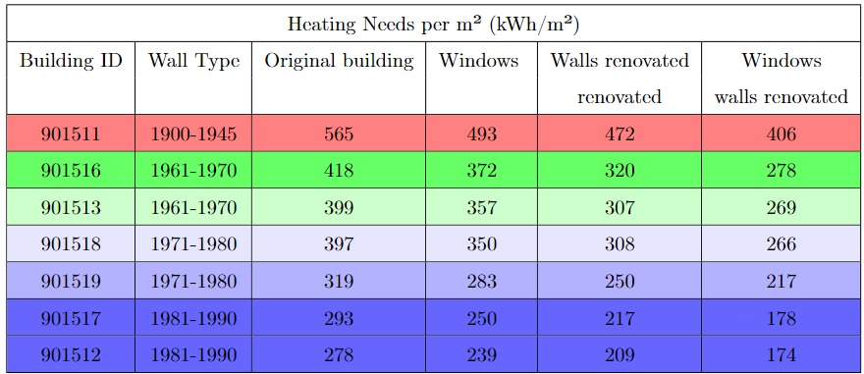
Heating/m2 martigny

Slide 43
Result from wall & windows renovations Verbier

Slide 44
RegBL (Registre fédéral des bâtiments et logements)
statistical register containing data on all buildings in Switzerland, updated by communal building departments and managed by the Federal Statistical Office.
information on construction projects, buildings, dwellings, entrances, and streets, and is used for statistical, research, planning, and legal purposes.

Slide 45
National official mensuration
Geometric information + EGID (Unique building identifier)

Slide 46
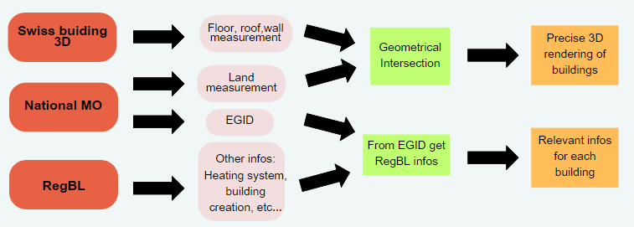

ELEMENTS TO RUN CITYSIM SIMULATION
Valais case

Slide 47
SWISS Building 3D
1. Vector data set that represents buildings modeled in 3D with high accuracy and extensive coverage.
2. Modeling is based on current digital aerial photograph strips from swisstopo, with roofs captured in 3D by photogrammetry and other elements automatically generated in post-processing.
3. Used in various fields such as 3D visualizations, land use planning, visibility analysis, shadow calculations, propagation analysis, solar energy potential calculation, natural event simulations, and urban ecology and climatology.

Slide 48
ELEMENTS TO RUN
Normal case

Slide 49
Flowchart
Database
Extract Geopackage
Select zone of interest in QGIS
xml file for city sim
Simulation with CitySim
Output file

Slide 50
Flowchart
Database
Extract Geopackage
Select zone of interest in QGIS
xml file for city sim
Geometry + EGID
Output file
Simulation with CitySim

Slide 51
Flowchart
Database
Extract Geopackage
Select zone of interest
RegBL API to get building infos
Geometry + EGID
Using EGID
Output file
Simulation with CitySim
xml file for city sim

Slide 52
Picking case studies

Slide 53
New database for valais

